Slide 1
Making the Most of Your Time (Series) Signal Processing for Machine Learning Applications
Keith R. Santarelli, Ph. D.
Data Scientist, Agero Inc.
ODSC East, May 2018

Slide 2
Who is Agero?
We’re an industry-leading provider of roadside assistance throughout North America:
Over 40 year history of helping driver and increasing customer loyalty.
Protect over 80 million drivers with over 10 million dispatches annually.
Extensive national network of roadside and towing partners.
Partner with both automotive manufacturers and insurance carriers.
We’re using cell phone technology to improve the roadside experience:
Apps to request assistance, receive real-time updates on service provider location.
Using the sensors inside of cell phones to improve driver safety.

Slide 3
How Are We Trying to Improve Driver Safety?
Our MileUp app provides access to phone sensor data in exchange for points that can be redeemed for gift cards.
Two primary uses for sensor data:
Real-time accident detection: detect an accident when it happens to check on driver, dispatch roadside assistance, or alert EMS.
Driver behavior detection and coaching: compile a picture of how well people drive and provide them feedback on how to drive more safely. Warn users if they’re:
excessively speeding.
jamming on their brakes too much.
texting while driving.

Slide 4
Data Science Model
Ultimately, we use Machine Learning to make decisions (e.g., if vehicle is involved in accident, whether and how someone can improve their driving). Typically, this means we need to extract a set of features that we can use to train an ML model.
Our input data from the phone comprises a set of raw time series measurements, otherwise known as signals.
Signal processing is a set of tools that can be used to remove artifacts from data (e.g. noise, biases) and which can ultimately be used to extract relevant features from time series.
Signals (Time Series)
Features
Decisions
Signal Processing
Hard braking
Machine Learning
Accelerometer
Accident?
Gyroscope
Accel. spike
Driving Improvements
GPS
Phone Usage

Slide 5
Our Focus Today: Filtering
Filtering is the process of separating a time series into different components.
Example filter:
Primary filtering applications:
Removing unwanted components.
Separating out “mixtures” into constituent components.
✓
Hot, goopy mess = grounds + coffee
✘
✓

Slide 6
Filtering For Time Series Analysis in Mobile Telematics
General model for removing unwanted components:
s_{m}: measured sensor signal (e.g., gyroscope)
s_{d}: desired/ideal signal in the absence of any corruption
n: noise corruption--electromagnetic interference, high
frequency vibration, etc.
b: bias corruption—small, constant offsets in a sensor’s
measurement output.
Example model for separating out mixtures (accelerometer):
a_{d}: acceleration of phone
g: gravity vector (used in determining phone orientation)
✓
✘
✘
✓
✓
✘
✘

Slide 7
Examples of Simple Filters
Some of the simplest filters are the results of rolling computations that compute simple statistical measures over a sliding window of data.
Rolling mean: filtered time series is the result of computing the mean of the N previous measurements to the current time.
Rolling median: filtered time series is the result of computing the median of the N previous measurements to the current time.
Examples: Jupyter notebook

Slide 8
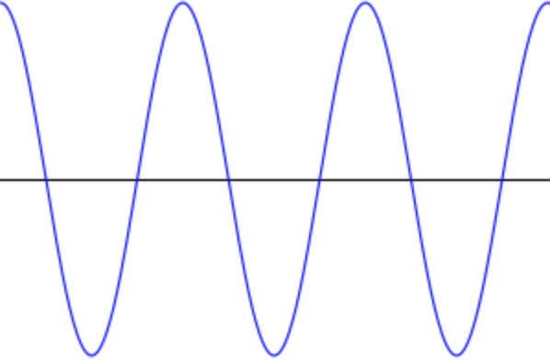
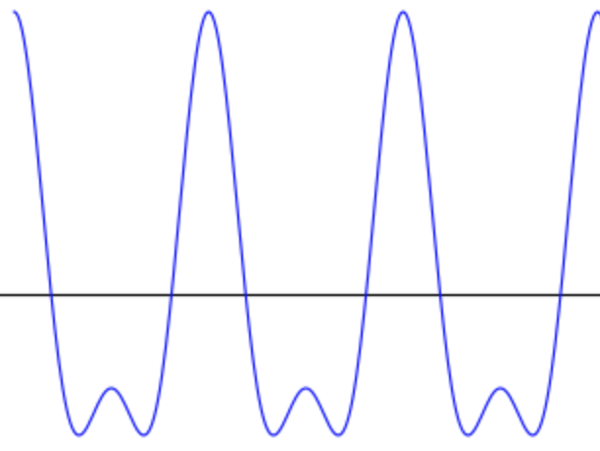
From Time Series to Frequency Series
Rather than representing our data as a collection of values at different times, we can equivalently represent our data as a collection of values at different frequencies.
t (sec)
1
2
3
1
2
3
t (sec)
1
1
0.5
f (Hz)
f (Hz)
1
1
2

Slide 9
The Fast Fourier Transform
Given a time series x(t), we can compute its equivalent frequency representation X(f) by computing the Fourier Transform:
The Fast Fourier Transform (FFT) is an efficient algorithm for computing the Fourier Transform based on the samples of a time series. For N samples of a time series, we can compute the FFT in O(N log₂N) operations.
Inverse FFT (IFFT) reproduces originally time series samples, also in
O(N log₂N) operations.
Examples: Jupyter notebook

Slide 10
Linear Filtering in Frequency Domain
Linear filters select certain regions in frequency space and reject others.
Achieved by multiplying our frequency spectrum by a weighting function W(f) (the filter!). Conceptually:
Multiply by W(f)
FFT
IFFT
W(f)
W(f)
W(f)
f (Hz)
f (Hz)
f (Hz)
Lowpass Filter
Highpass Filter
Bandpass Filter

Slide 11
Common Lowpass Filters
Butterworth Filter
Maximally flat (no ripples) in pass band or stop band.
Gradual transition between pass band and stop band.
Chebyshev Filter
Ripple in either the pass band OR the stop band
Sharper transition between pass band and stop band.
Elliptic Filter
Ripple in pass band AND stop band.
Sharpest transition from pass band to stop band.
All of these filters have highpass and bandpass counterparts.
Butterworth Filtering: Jupyter notebook

Slide 12
Signal Processing for Machine Learning: Filter Banks
FFTs often provide a natural framework for creating features.
A filter bank breaks up the FFT of a time series into a sequence of bands. The energy in each band is used as a feature in a machine learning algorithm.
Variants of this idea often used in speech processing.
W₁(f)
Feature 1
f
W₂(f)
Feature 2
f
W₃(f)
Feature 3
f

Slide 13
ML Feature Extraction in Mobile Sensing
One of the features we compute to assess driving behavior is the presence of hard braking or hard acceleration events. Occurs when magnitude of the acceleration vector persistently exceeds a certain threshold:
Problem: “cheap” gravity estimation can cause processed accelerations have significant gravity removal errors that cause both false positives and false negatives.
|a|
a_{thresh}
|a| exceeds a_{thresh} for ΔT > ΔT_{min} seconds
ΔT
t
measured
actual
|a|
|a|
False positive
False negative
a_{thresh}
a_{thresh}
a_{thresh} 0.3g
Δg > 0.1g
Notes:
Notes: athresh roughly 0.3g, errors are often 0.1g or more.

Slide 14
Improving Gravity Estimation: Sensor Fusion
Sensor fusion is a class of signal processing methods that combines information from different types of sensors to estimate information that can’t be obtained by one sensor type alone.
Example: Simultaneous Localization and Mapping for aircraft combines data from a GPS and camera to record a sequence of landmarks and create a map of an area.
Camera extracts landmarks, GPS determines location.
Camera and landmark locations can be used to navigate area if GPS reception is lost.
Primary tool used to estimate gravity is a Kalman Filter, a probabilistic approach to combining data from multiple sensors. Inputs:
Sensor measurements (accelerometer, gyroscope, GPS…)
Model for errors in our sensor measurements, typically in the form of a covariance matrix.
Kalman Filter automatically weights the contribution from different sensors as a function of the sensor inputs and the “size” of the covariance matrices at each point in time.
If a sensor begins to appear more noisy, Kalman Filter decreases the weight on the contribution from that sensor.
Notes:
Why not just use GPS all the time then? 1 Hz fidelity isn’t enough for us; need 10-100Hz accelerometer data.

Slide 15
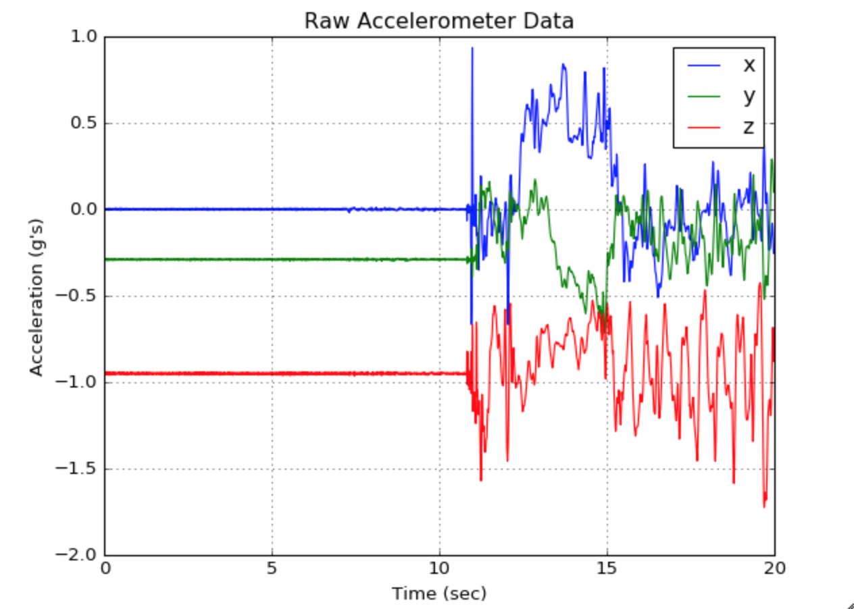
Kalman Filtering for Gravity Estimation via Accelerometer and Gyroscope
Accelerometer can be used to estimate gravity during “quiet” periods.
Pro: generally very accurate during quiet periods.
Con: no estimate available when phone is moving.
Gyroscope-aided estimation: given initial estimate of gravity vector, gyroscope data can be used to compute change in phone orientation over time. Can rotate initial gravity vector estimate using phone orientation estimate.
Pro: can be used to estimate gravity during periods where we can’t ”read off” estimate from accelerometer.
Con: noise in gyroscope data leads to significant drift over time, so estimate eventually becomes inaccurate.
Time period for accelerometer gravity estimate
Time period for gyro-aided gravity estimate

Slide 16
Kalman Filtering for Gravity Estimation via Accelerometer and Gyroscope (Cont’d)
Sensor covariances:
Σ_{g}: covariance matrix for gyroscope sensor noise data, typically constant.
Σ_{a}(t): covariance matrix for acceleration data. Combines inherent sensor noise in accelerometer with variation in raw acceleration. Typically non-constant and is higher when accelerometer data varies with time.
Variation in raw acceleration estimated via rolling variance:
Kalman Filter in a nutshell: emphasizes information from from sensor with smaller covariance at any given point in time to construct solution:
Variation Covariance
Noise covariance
weight
Gyroscope solution emphasized
Accelerometer solution emphasized

Slide 17

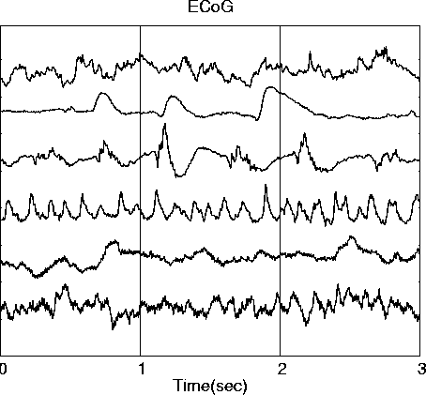
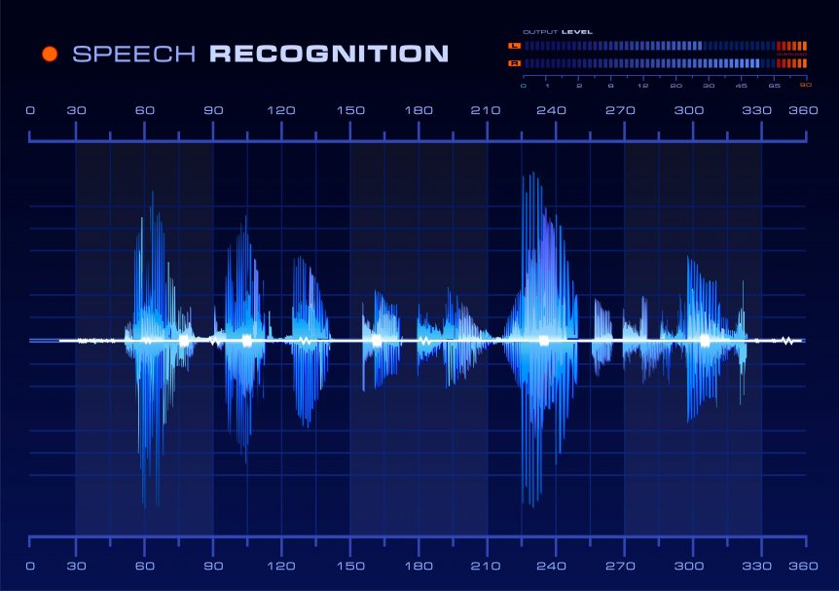

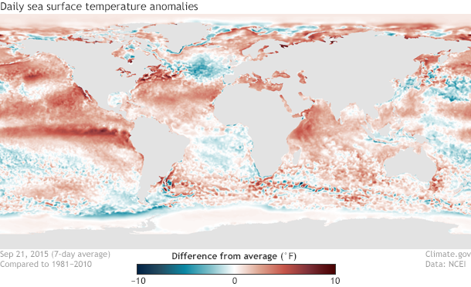
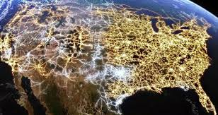
Time Series (and Signal Processing Applications) are Everywhere!
Finance
Speech Recognition
Biomedical
Clickstream Data
Climate Change
Power Grid
Notes:
Biomedical data, EEG signals
Power grid for dynamic pricing

Slide 18
Want to Learn More?
Reading
Signals and Systems by Oppenheim and Willsky. Great, easy-to-read introduction to basic concepts and theories in signal processing.
Principles of GNSS, Inertial, and Multisensor Integrated Navigation Systems by Groves is a great resource for learning about inertial sensor and GPS models, and has a decent introduction to Kalman Filtering.
Countless online tutorials!
Coding
scipy signal processing library has a LOT more functionality than what we discussed today.
pandas also has a number of tools for organizing and manipulating time series data.
FilterPy is a great, easy-to-use package that implements a lot of different Kalman Filtering models and makes it easy to get up-and-running with Kalman Filtering on short order. Also has great tutorial examples on different types of Kalman Filtering (linear, extended, unscented, etc.)

Slide 19
Back-up

Slide 20
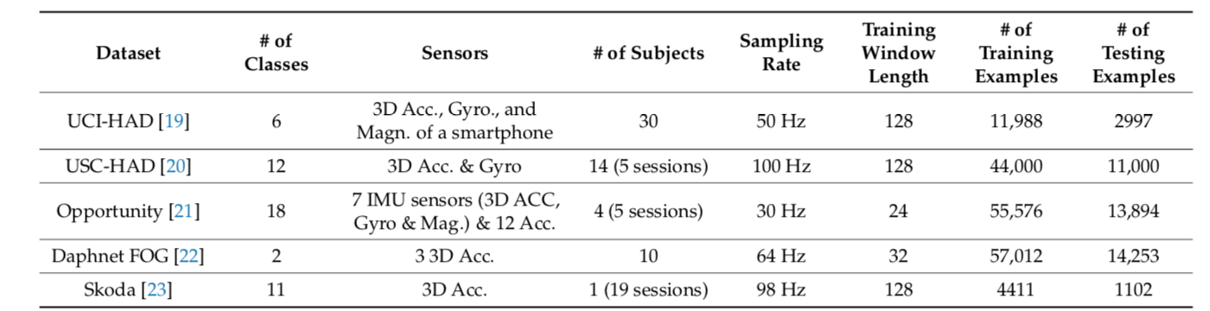
Signal Processing vs. Deep Learning
Deep Learning can automatically learn features for us. Why bother with this extra pre-processing step?
Main reason we can’t always use Deep Learning in mobile telematics: the amount of data that’s required to train the model isn’t available from the get-go.
Example: using Deep Learning on sensor data for human activity recognition*
~2 hrs of labelled data (11 classes) for shortest data set (Skoda)
~20 hrs of labelled data (12 classes) for longest data set (USC-HAD)
Collecting labelled data can be time-consuming!
Agero ran a labelled data collection effort last fall to collect 400 training examples of a particular driving event.
8 weeks of planning, 1 full week of executing experiment.
Murad A. and Pyun J, “Deep Recurrent Neural Networks for Human Activity Recognition,” Sensors (17): 2556, 2017
Notes:
Other things to point out we’re aware of: smaller data sets if we’re good at tuning deep learning algorithms.

Slide 21
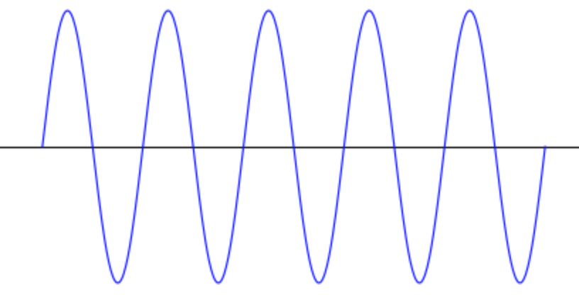
Advantages of Signal Processing
Doesn’t require extremely large data sets. You can start with just a handful of representative data to gain intuition.
Doesn’t preclude you from eventually using Deep Learning-like tools later on as you build up your data set.
Typically very fast in initial analysis phases (i.e., before batch processing). Great for running experiments in interactive environments (e.g., Jupyter notebook).
Signal processing is crucial knowledge base for properly designing data acquisition systems.
Example: sampling 1 Hz sine wave at a 1 Hz data rate:
Need to sample at a minimum 2Hz rate.
NO amount of machine learning can recover lost information!

